Slide 1







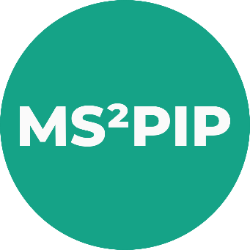


Open modification search (OMS)
+1000 known modifications/artifacts
Amino acid substitutions
Semi-tryptic peptides
Modifications only observed in MS1
AI predicted LC-MS/MS peptide behaviour for accurate PSM matching.
Substantial increase in peptide identifications over OMS by considering highly likely co-eluting matches.
Can be tailored to specific experimental conditions (e.g. TMT).
Highly competitive with state-of-the-art OMS engines.
Is available in the cloud!
ionbot.cloud
Degroeve S. et al, bioRxiv, https://doi.org/10.1101/2021.07.02.450686

Slide 2
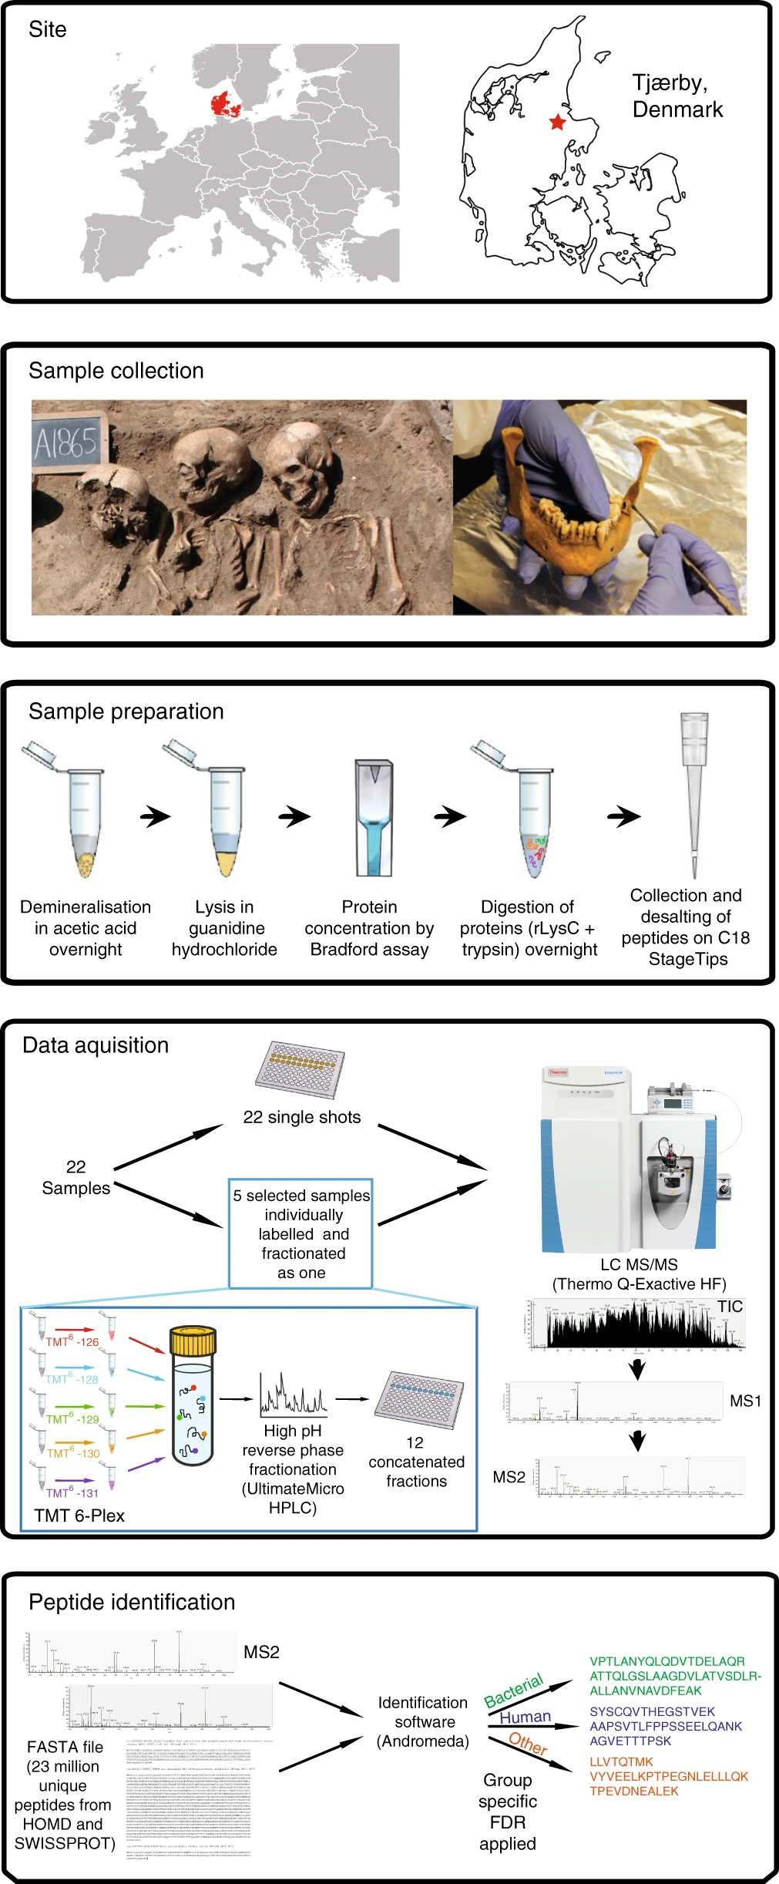
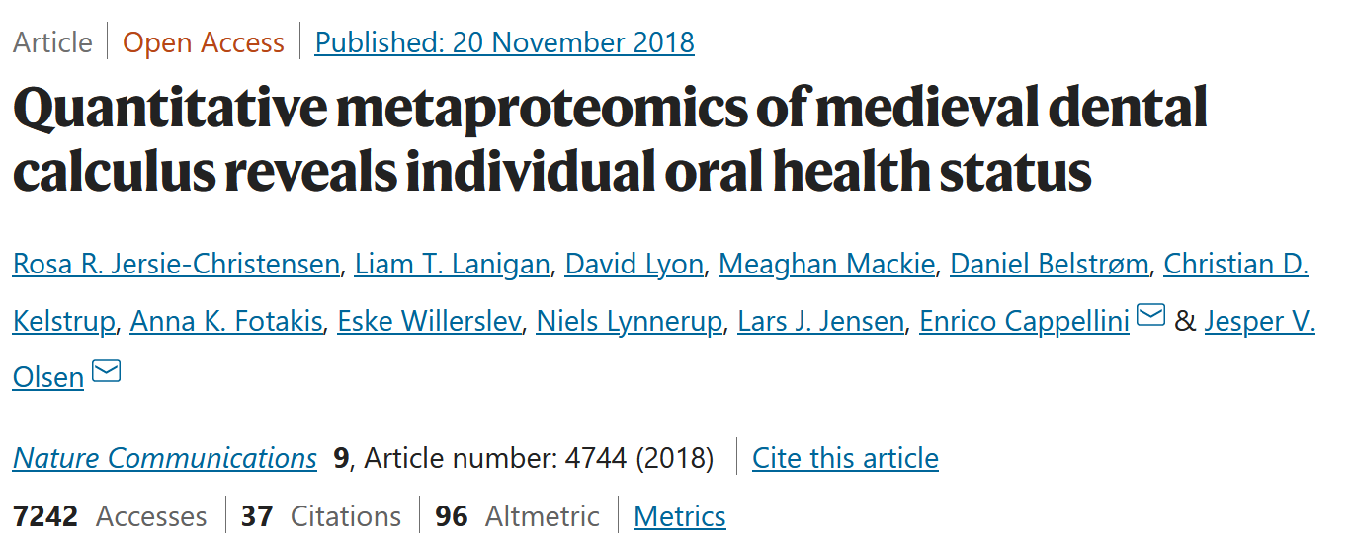

Slide 4


Slide 5
Procedure:
ionbot OMS with Carbamidomethyl(C) as fixed and Oxidation(M) as variable
Filter target database for identified proteins
ionbot OMS with
Carbamidomethyl(C)
Oxidation(M)
Oxidation(P)
Deamidated(N)
Deamidated(Q)
Glu->pyro-Glu+Methyl:2H(2)13C(1)(E)
Acetyl(N-term)
Methyl(D)
Methyl(E)
(OMS = max 2 variable + 1 unexpected modification)

Slide 6
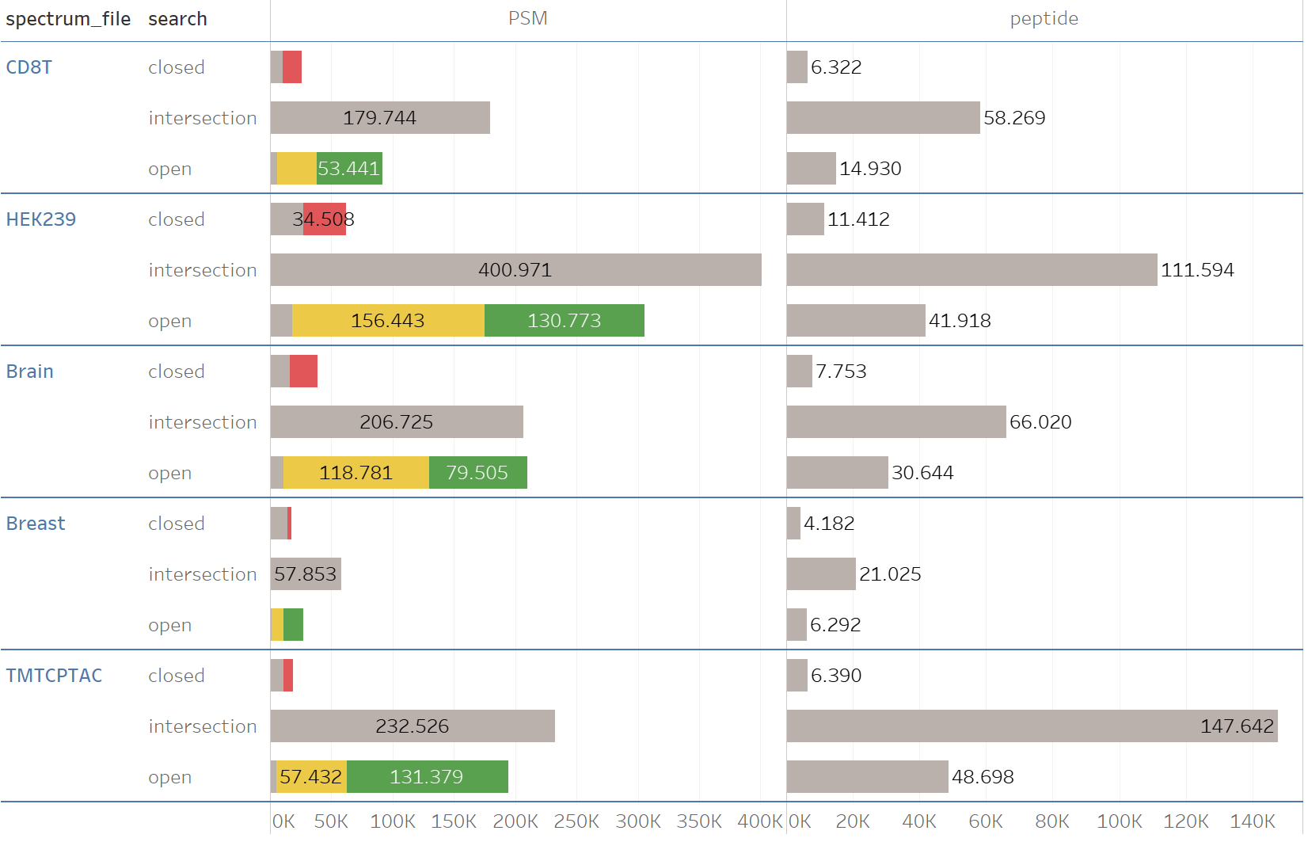

Slide 7



github.com/RobbinBouwmeester/ionbot.workshop
Contact:
sven.degroeve@ugent.be (general)
Lennart.martens@ugent.be (general)
kevin.velghe@ugent.be (tech issues)
ralf.gabriels@ugent.be (feature reqs)
robbin.bouwmeester@ugent.be (feature reqs)
enrico.massignani@ugent.be (running ionbot)
mybinder.org
anaconda.com/products/distribution

Slide 8
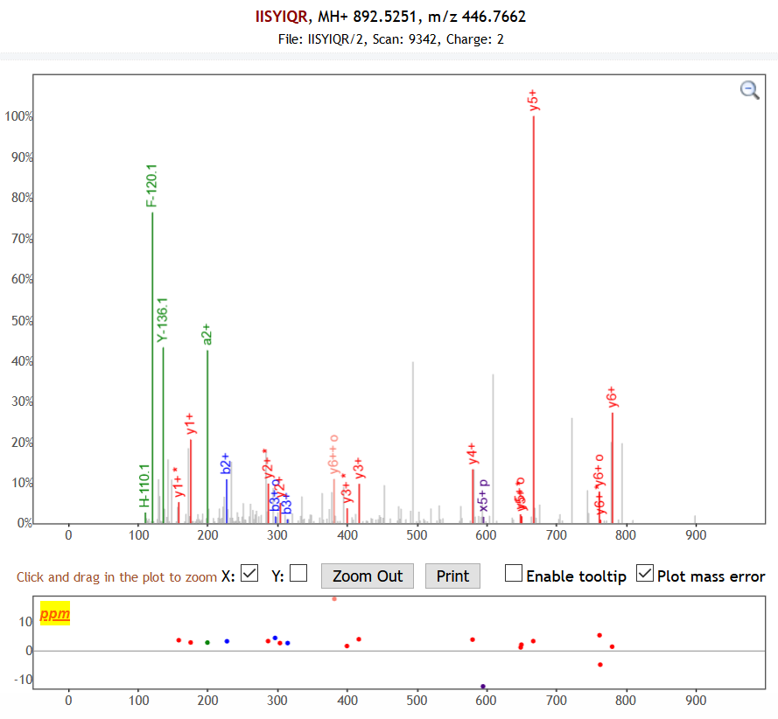
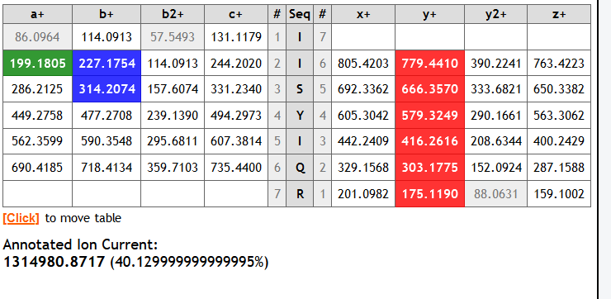

Slide 9
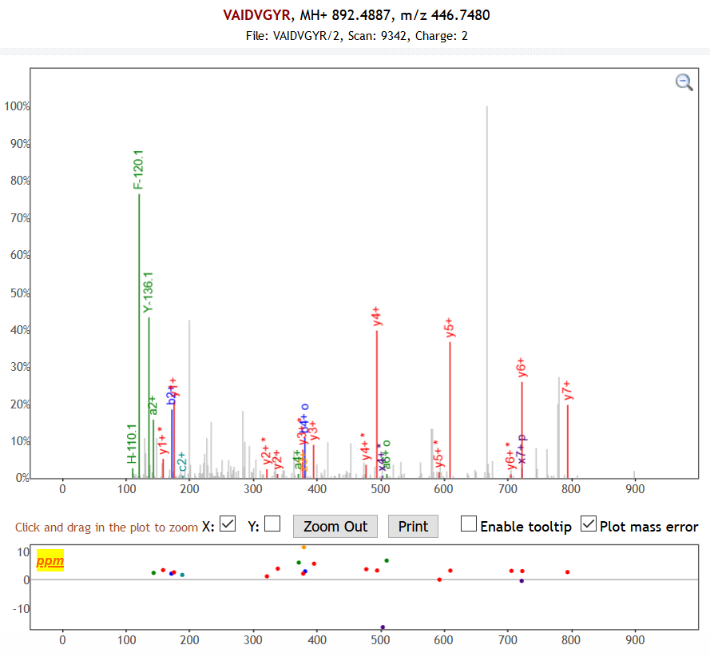
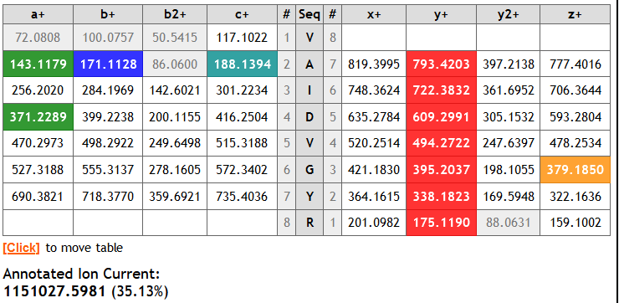

Slide 10
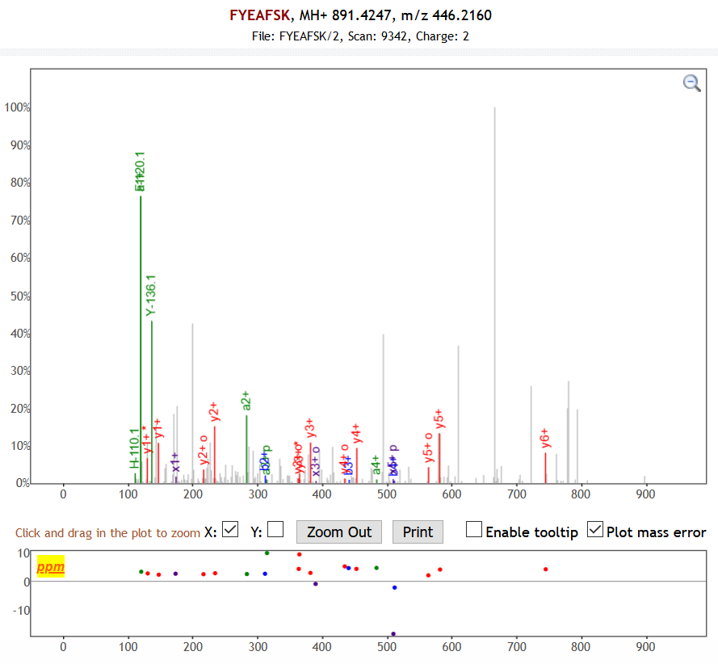
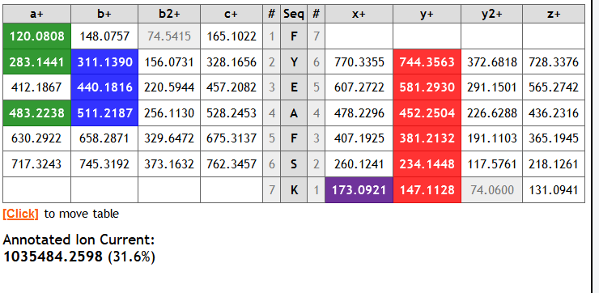

Slide 11
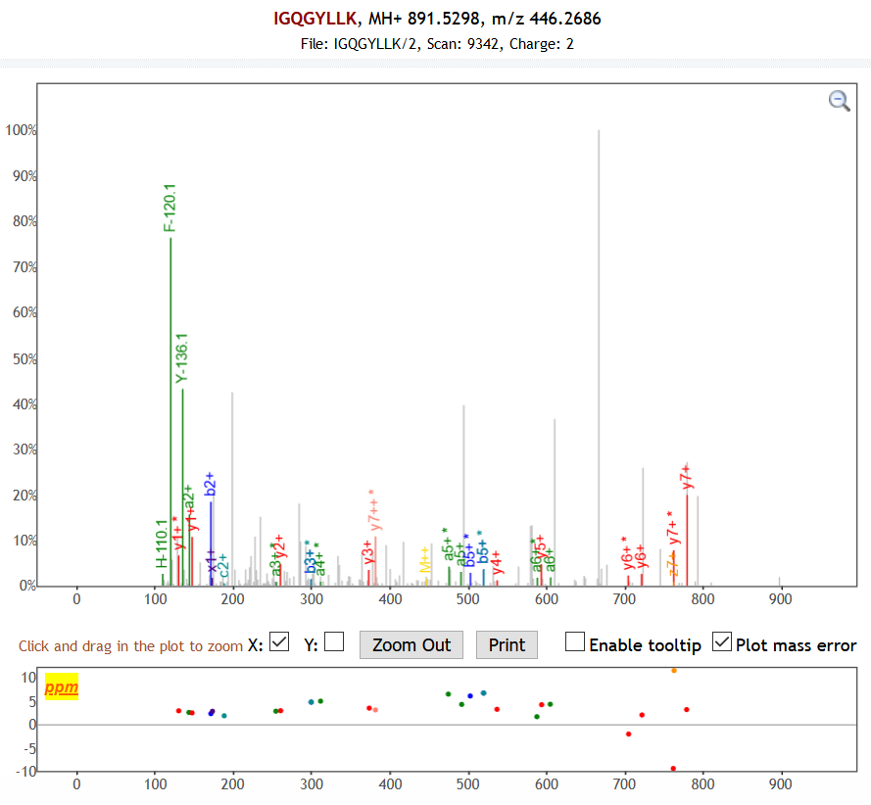
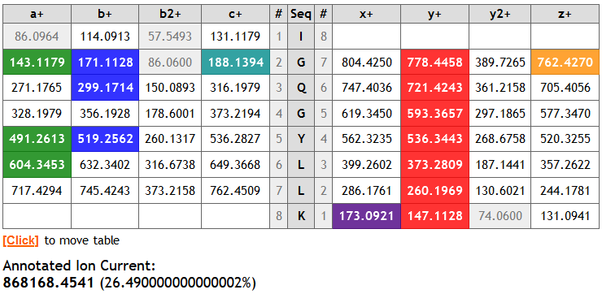

Slide 12
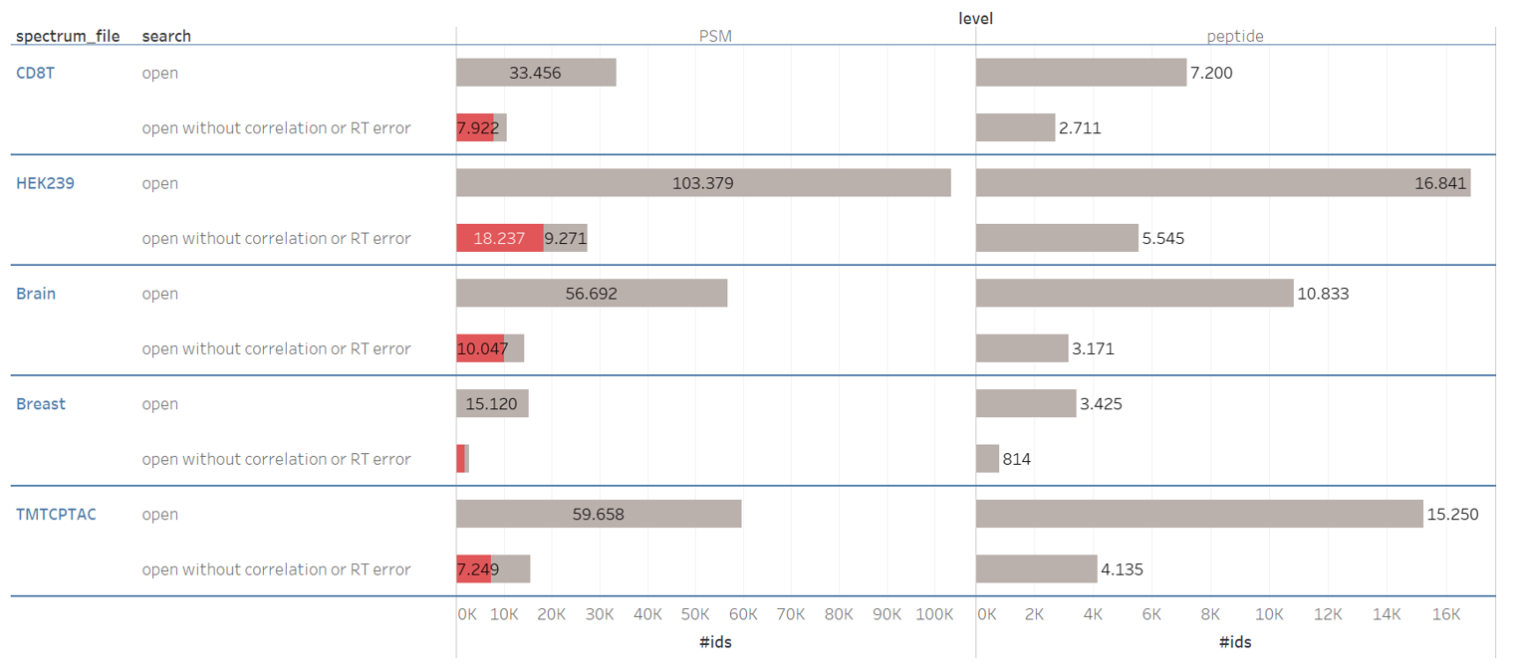

Slide 13
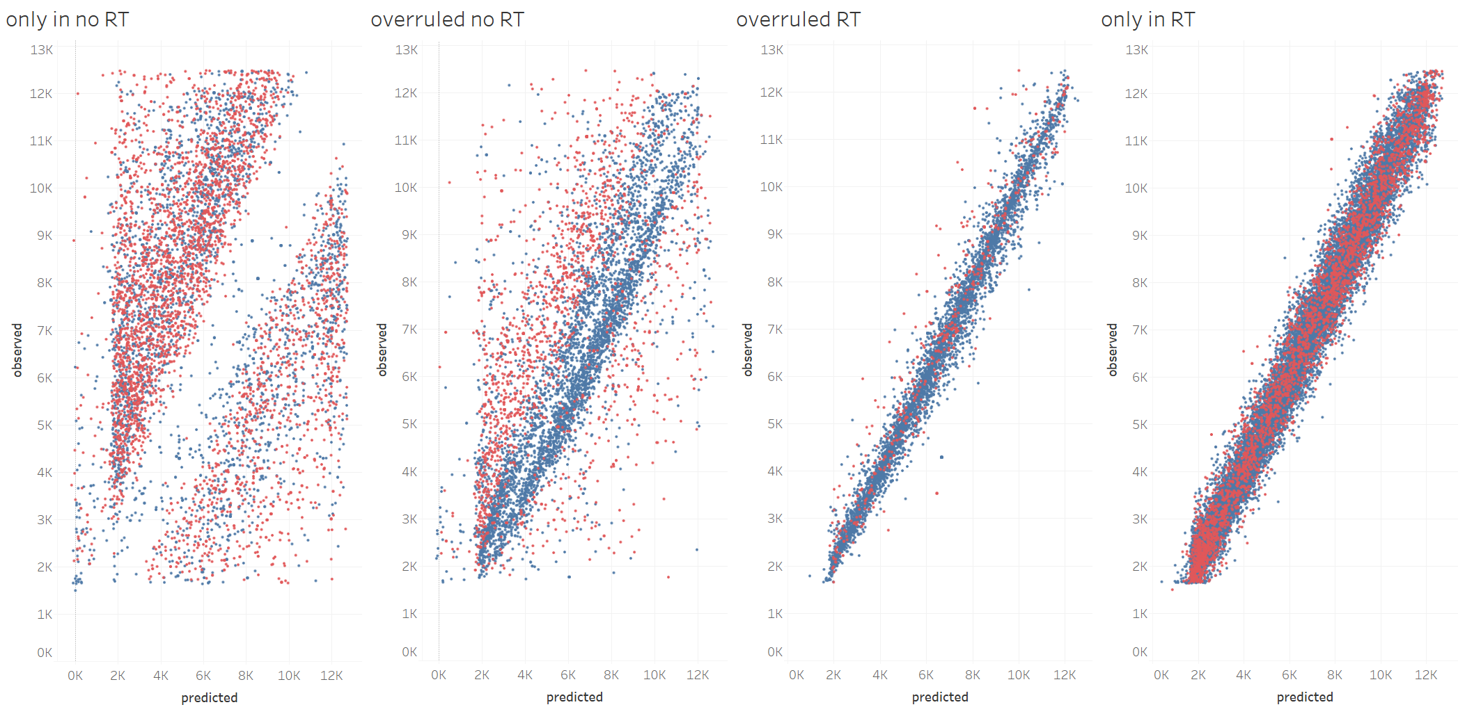

Slide 14




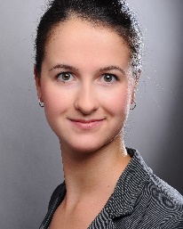

















www.compomics.com
@compomics

